Slide 1
Classification Of Subreddit Posts
Nicholas Lim
Irwin Wei
Michelle Ng

Slide 2
Outline
Problem Statement
Data Information
Data Cleaning
Nicholas’ Models
Irwin’s Models
Michelle’s Models

Slide 3
Data Cleaning
We generally formatted the data using the following steps:
Filled posts that only contained images/video clips with blank quotes (‘’)
Title and content of posts were merged to one single string of text
Removed non-letters (numerics, new line separators, punctuations)
Stop words removed using nltk’s library of stopwords
Lemmatization and stemming were experimented with the data
Removed keywords found in the subreddit title from posts
Removed Reddit links from posts using regex

Slide 4
Problem Statement
To classify posts from 2 different subreddits, /r/depression and /r/anxiety.
Motivation: Help reddit users who may be suffering from either depression or anxiety issues but not properly diagnosed to get the correct advice through posting at proper channels

Slide 5
About the data
Total of 1943 rows of data
998 from r/Anxiety
945 from r/depression
Source:
www.reddit.com/r/depression
www.reddit.com/r/anxiety

Slide 6
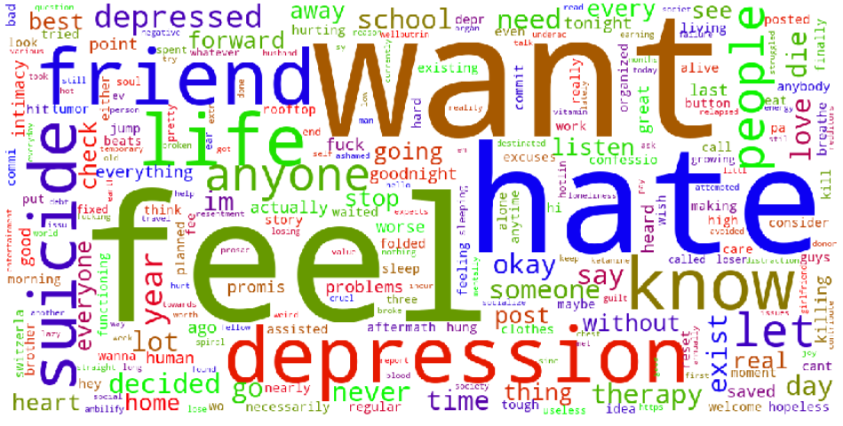
Frequent Words in r/depression

Slide 7
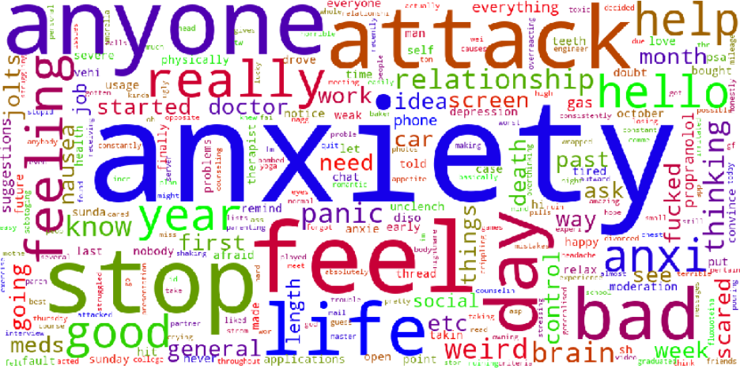
Frequent Words in r/Anxiety

Slide 8
Modeling
Model | Train Score (CountVectorized) | Test Score (CountVectorized) | Train Score (TfidfVectorized) | Test Score (TfidfVectorized)
Logistic Regression | 0.8277 | 0.821 | 0.8538 | 0.8416
K-Nearest Neighbours | 0.7076 | 0.6749 | 0.7804 | 0.7737
Naive Bayes (Multinomial) | 0.8476 | 0.8313 | 0.8428 | 0.8025
Decision Tree | 0.7955 | 0.7922 | 0.8016 | 0.7984
Random Forest | 0.8627 | 0.8374 | 0.86 | 0.8477
Extra Tree | 0.8298 | 0.7963 | 0.8469 | 0.8004

Slide 9
Model Evaluation
Model | Correct /r/depression posts predicted | Correct /r/anxiety posts predicted
Logistic Regression with TfidfVectorization | 197/236 | 212/250
Random Forest with TfidfVectorization | 198/236 | 214/250

Slide 10
Conclusion
Random Forest with TfidfVectorizer worked fairly well with an accuracy score of close to 85%, even though both subreddits were fairly similar in nature.
Logistic Regression with TfidfVectorizer also works equally well as well with an accuracy score of 84%
Scope can be expanded to include the following to further improve the models:
Include lemmatization, stemming and spell checks to have a general feel of the posts
Include more subreddits (eg. bipolar) in our classification model. This may be further extended to be used as an initial diagnosis of any mental issues that the user might be suffering from.
Tuning of parameters for random forest to get a better score. However, this requires a longer amount of time to tune to get the perfect parameters.
Consider either boosting or bagging to get a more optimal outcome.

Slide 11
Irwin:
r/TalesFromTheCustomer r/TalesFromYourServer
r/TalesFromTheCustomer:
Accounts of poor customer service encountered by contributors. 997 posts
r/TalesFromYourServer:
Comprises contributions from people who work(ed) as waiters/waitresses regarding unreasonable customers they encountered at work. 996 posts
Problem Statement:
To differentiate between both types of posts so that a service provider can obtain insights on pain points experienced by customers and their staff, so as to bolster staff training and psychological preparedness.

Slide 12
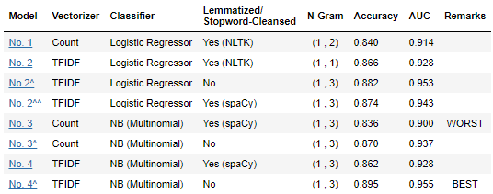
Main Challenge:
Very similar words (nouns, adjectives etc.)
General Approach:
- Combinations of text pre-processing, vectorization & classifier
- For each combination, iteratively apply GridSearch to find optimum parameters
RESULTS!

Slide 13
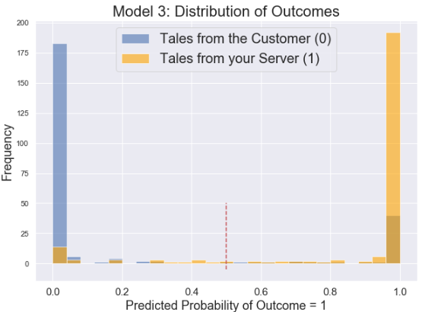
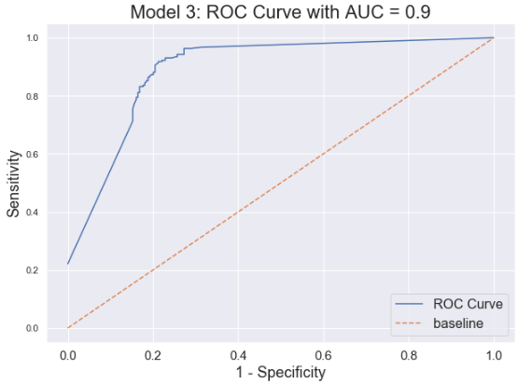
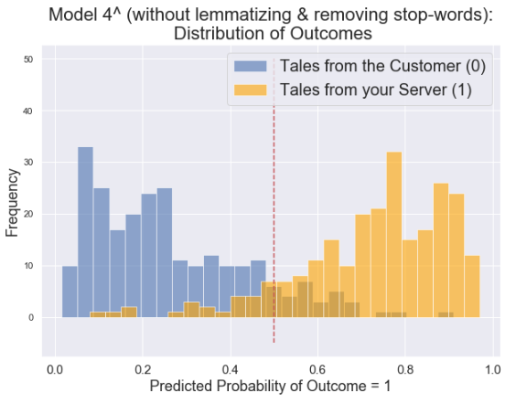
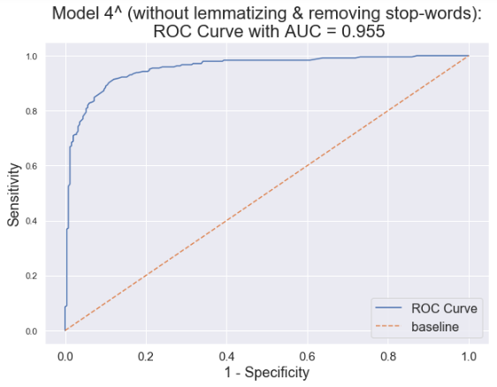
Model 3
Ngram = (1,3)
Model 4^
Ngram = (1,3)

Slide 14
Michelle:
R/Relationship_advice and R/JUSTNOMIL
Problem Statement:
How can we accurately predict whether a post is from R/relationship_advice or R/JUSTNOMIL?
Importance:
To provide a ‘triage’ for advice as R/JUSTNOMIL may need more time sensitive, immediate responses (emotional support and legal advice).
Data:
981 Relationship advice
990 JUSTNOMIL

Slide 15
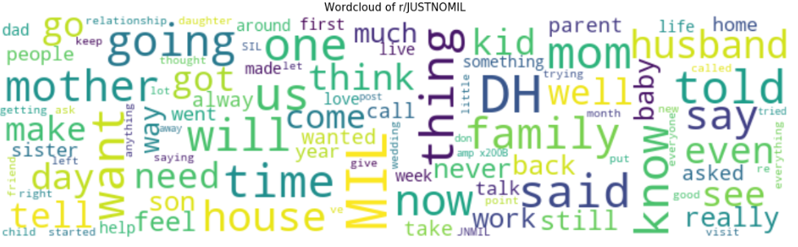
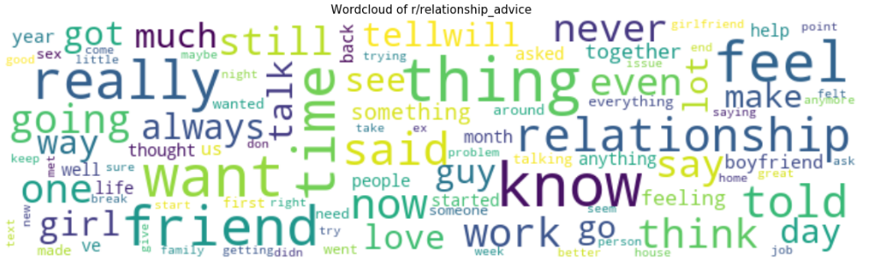
Modeling
Notes:
We can see that MIL and relationships are really big
So I lemmatised the words, and then removed the stop words

Slide 16
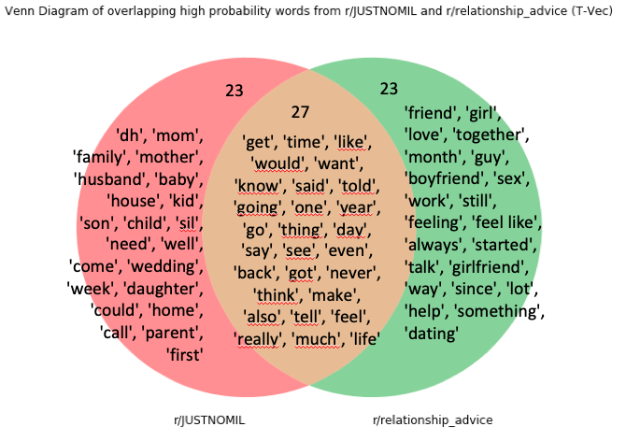
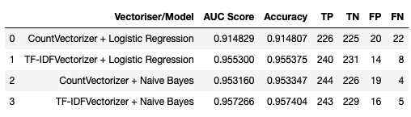
Scores and Details of the Models
Notes:
-Logistic Regression seems to be less accurate
-Models with TF-IDF Vectorizer tend to have less wrong classifications
-
If it is possible, we can explore the following courses of action:
- introducing regularisation to the logistic regression model
- try decision trees instead
- develop tool further to decide on danger level of poster.

